Slide 1


Slide 2
Team Name : APTS Code Legends
Project Title : cloud based online blood bank management system.

Slide 3
Preliminary Information:
Under The Guidance of: Presented by Team Members :
MR. Yogesh Raje 1. LakshmiSandhya Sodasani
2. Sahil Gund
3. Pratik Gore
4. Abrar zafar
5. Sriram Thota
6. Sri Ratna Edara

Slide 4
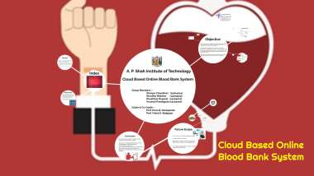

Slide 5
Agenda:
Definition of online blood bank management.
Problem Statement
User or Customer
wireframes
Project Goal.
Advantages.
Disadvantages.
Scope of Project.
Conclusion.

Slide 6


Slide 7
Online Blood Bank Management:
Web-based Blood Donation Management System is a management system website that enables individuals who want to donate blood to help the needy.
It also enables hospitals to record and store the data for people who want to communicate with them, and it also provides a centralized blood bank database.

Slide 8
Problem Statement :
This project is designed for successful completion of project on blood bank management system.
The basic building aim is to provide blood donation service to the city recently.
The system will provide the user the option to look at the details of the existing Donor List, Blood Group and to add a new Donor.

Slide 9
The main objective of this application is to automate the complete operations of the blood bank .
They need maintain hundreds of thousands of records.
It also allows the user to modify the record.
The administrator can alter all the system data.

Slide 10
User / Customer
Blood is a saver of all existing lives in case of emergency needs. The task of blood bank is to receive blood from various donors, to monitor the blood groups database and to send the required blood during the need to the hospital in case of emergencies.
Administrator (this should be a general body, could be from central blood bank agency)
Blood Donors
Blood Banks, Hospitals, Clinics, etc.

Slide 11
Wireframes
Work Flow
Use Case Diagram

Slide 12
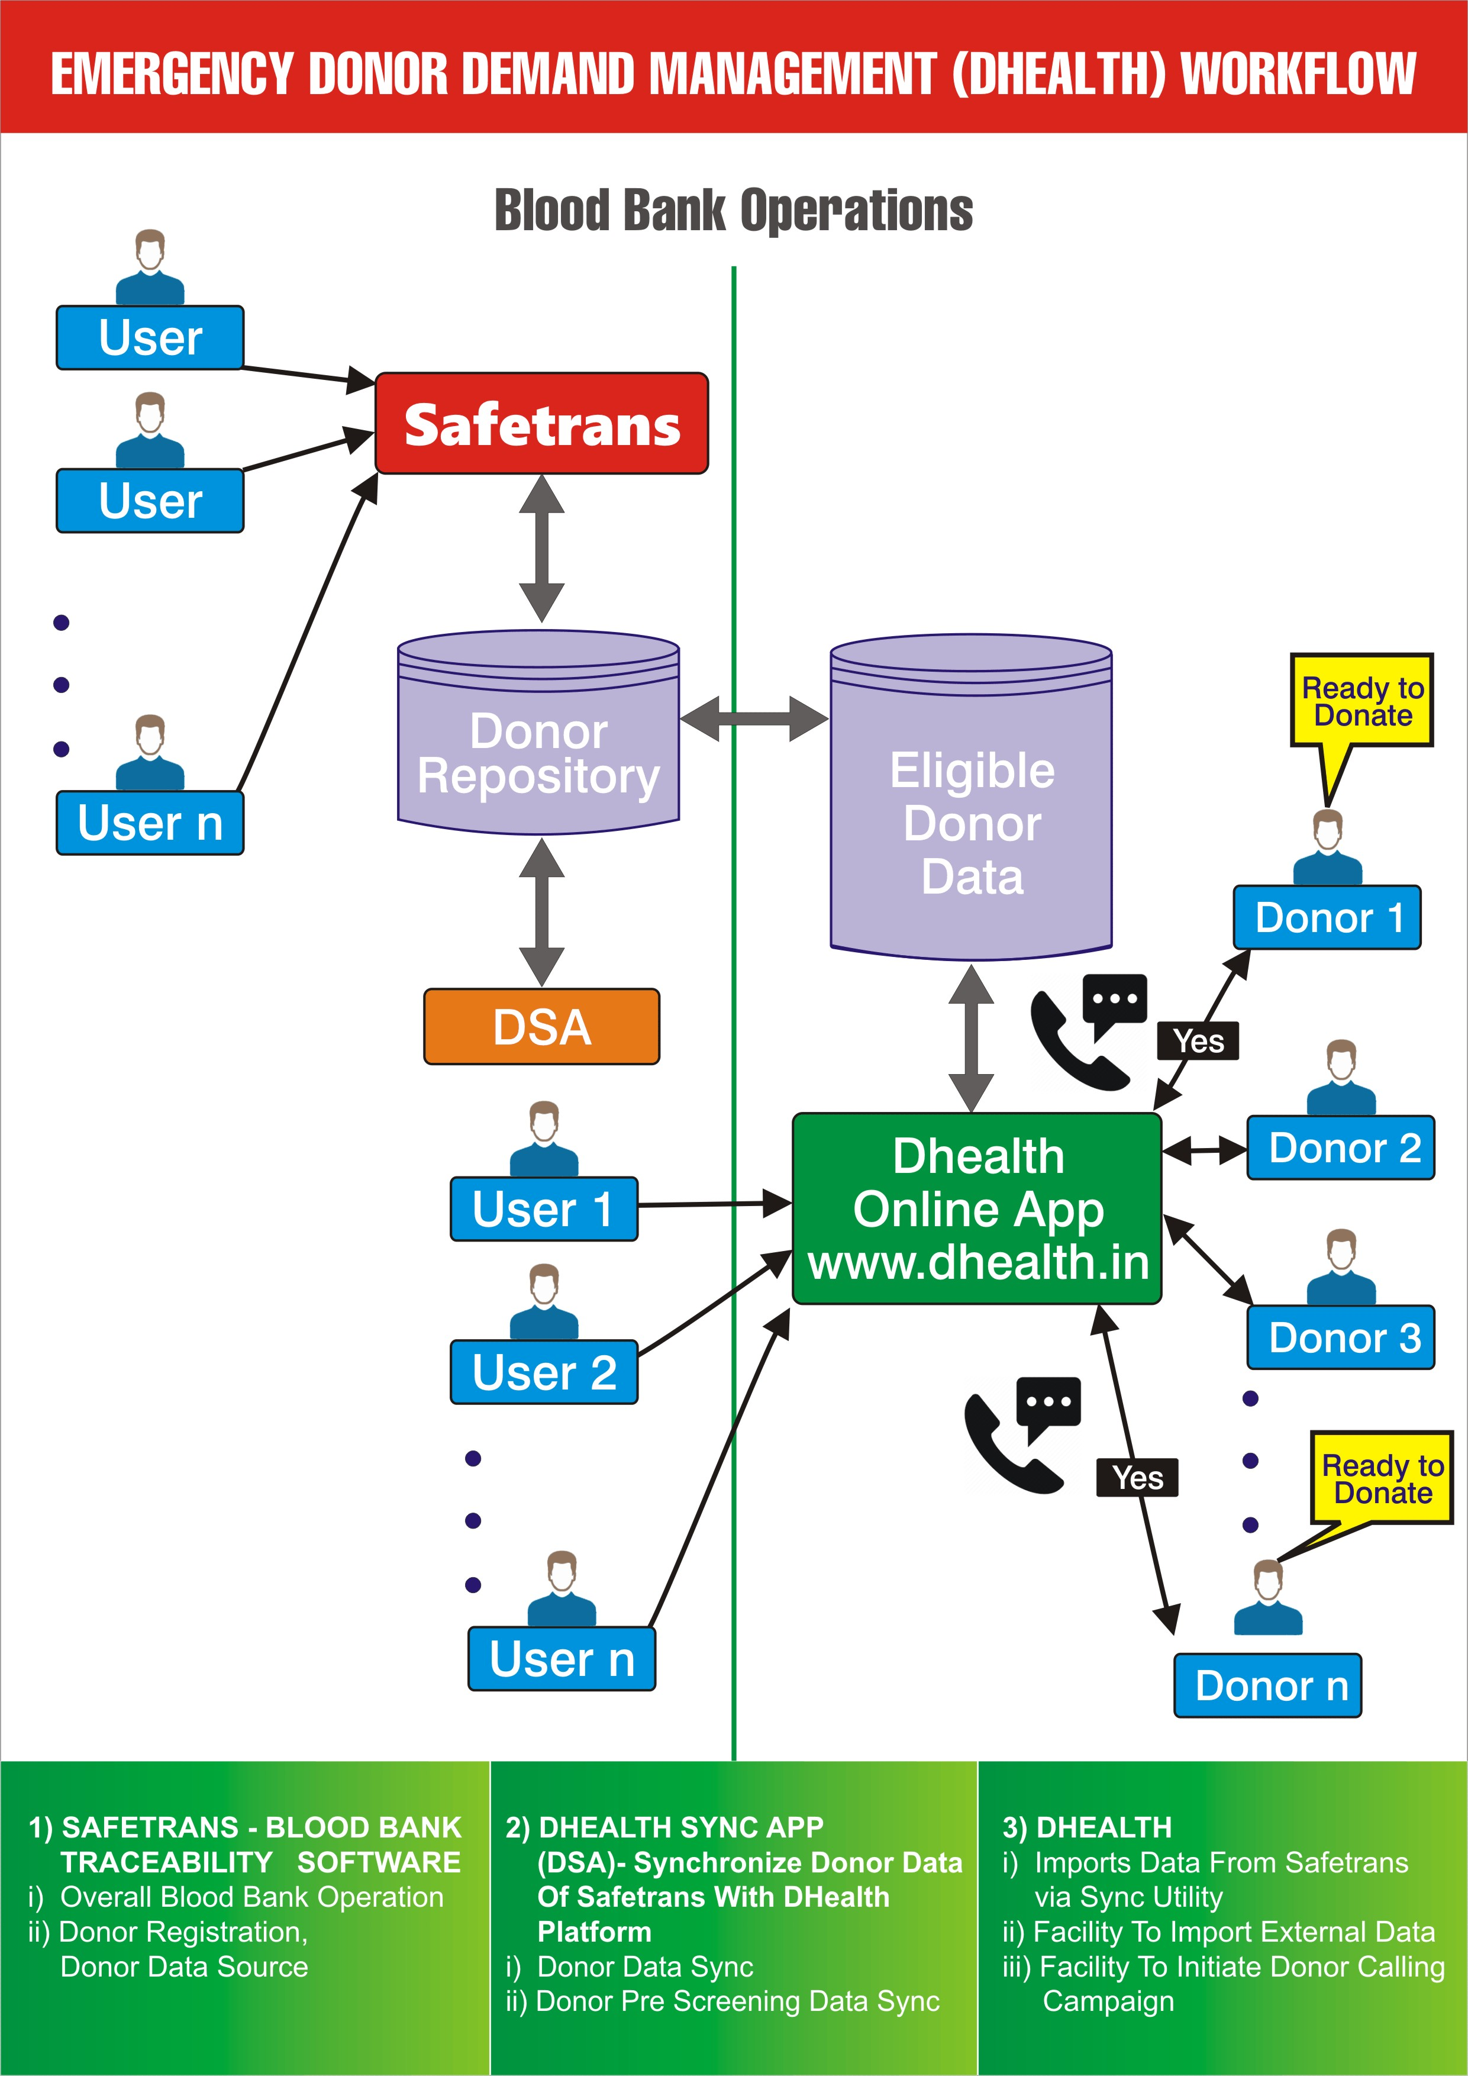
Work Flow :

Slide 13
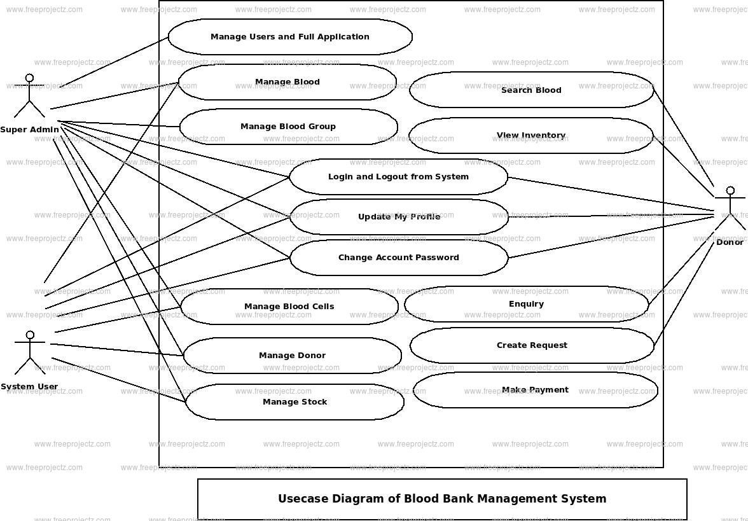
Use Case Diagram :

Slide 14
Project Goal
The main goal of the Blood Bank and Donor Management System project is to monitor Blood Bank data, Blood cells, Blood stock, Donor List.
It manages all the Blood Bank, Donor, Blood stock data.
The project is entirely administrative and therefore access is guaranteed only to the administrator.

Slide 15
Advantages :
The main advantage of a blood bank management system is easy and effective information retrieval. Hence, the staff can view precise information quickly.
This proposed Blood Bank Management System gives a reliable platform for both donors and acceptors.

Slide 16
Disadvantages:
What is the problem in blood bank management system? There is a dire need of synchronization between the blood donors and hospitals and the blood banks.
This improper management of blood leads to wastage of the available blood inventory.
Improper communication and synchronization between the blood banks and hospitals leads to wastage of the blood available.

Slide 17
Scope of Project
Blood donation management
Blood safety
Blood and blood component production.
Blood and blood component storage and distribution
Online platform for health checkup
Eradicate Corruption In Blood Distribution

Slide 18
Results
https://drive.google.com/file/d/12E0h6ia6tYij6QI8ESzWc7QM85T0Wa4X/view?usp=drivesdk

Slide 19
Conclusion
Our Project is a humble venture to satisfy the needs in a blood bank to manage their stock, inventory.

Slide 20


Slide 21


